Slide 1

CPU Scheduling
or
(Short Term Scheduling)
Maximize, utilization of most costly and most powerful component in a computer i.e. CPU, by sharing it for on-going parallel activities.

Slide 2
CPU (Short Term) Scheduling
Basic Concepts
Scheduling Criteria
Scheduling Algorithms
Multiple-Processor Scheduling
Real-Time Scheduling
Thread Scheduling
Operating Systems Examples
Java Thread Scheduling
Algorithm Evaluation

Slide 3
Basic Concepts
Maximum CPU utilization can be obtained with multiprogramming among different processes, having good mix of CPU and I/O bursts
CPU Burst Cycle (brief duration, of the order of micro seconds)
    Exclusively CPU is busy
    Un-disturbed computational activity
    Process execution consists of a cycle of CPU utilization
    CPU bound process; mainly having CPU bursts
I/O Burst Cycle (long duration, of the order of milliseconds or more)
    Exclusively I/O devices are performing I/O
    Slow I/O operations, waiting for I/O completion
    I/O bound process; mainly busy in I/O
CPU burst distribution
    CPU may be used for some process, while other processes might be waiting for I/O completion, i.e. alternating sequences of CPU And I/O Bursts
    Exploitation of parallelism between CPU burst and I/O burst for different processes, having good mix of CPU and I/O bursts
    Not good if all processes are exclusively CPU bound or I/O bound only

Slide 4

Alternating Sequence of CPU And I/O Bursts

Slide 5
Switching of Process States
(between Executing, Ready and Blocked)
Switching of a process state during Sequence of CPU and I/O bursts
Executing – Performing I/O – Ready - Executing
Executing
I/O Request
I/O Request
I/O Request
Ready
I/O done
I/O done
Performing I/O
time

Slide 6

Histogram of CPU-burst Times
On average the probability of short CPU bursts (for I/O bound processes) is very high as compared to long CPU bursts (for compute bound processes)

Slide 7
Scheduling Types
  Non-preemptive Scheduling:
    Running process holds the CPU till its completion
    CPU doesn't leave the executing process
    Under utilization of resources
  Preemptive Scheduling:
    A Process can leave CPU temporarily even before completion.
    CPU switches among processes (needs time quantum up interrupt)
    Meanwhile the CPU is allocated to some other process
    Better utilization of resources
    Exploitation of parallelism (better execution speed):
        CPU and I/O devices can work concurrently
        Multiple I/O devices can work concurrently (CPU activates I/O)

Slide 8
5 States Diagram of Process State
Short Term Dispatch Scheduler
(Selection among processes from ready queue)
Allocate CPU to some ready process, while other processes might be waiting for I/O completion

Slide 9
CPU Scheduler (short term or dispatch scheduler)
Select one process from the processes that are ready to execute, and allocates the CPU to the selected one
CPU scheduling decisions shall take place when
  1. Resource request is made, process switches from running to waiting state for some resource or to perform I/O
  2. Time Quantum up interrupt occurs, process switches from running to ready state to let some other process to execute
  3. CPU is to be allocated to other process, some process switches from ready to running state on CPU allocation by dispatcher
  4. Process Exits or Terminates, on orderly exit or aborts on certain error

Slide 10
Dispatcher
Dispatcher module gives control of the CPU to a process selected by the short-term scheduler; this involves:
    Context switching in Kernel mode
    Switching back to user mode
    Jumping to the proper location in the user program to restart next program
Dispatch latency – time taken by the dispatcher to stop one process (by saving its context in PCB) and start another process for running (by loading context from PCB of an other process)

Slide 11

CPU Switching From Process P0 to P1 and to P0 again
Context-switching overhead
Context-switching overhead

Slide 12
CPU Scheduling
Maximize system’s utilization – keep the CPU and other computational resources as busy as possible
Some Definitions
  Throughput – # of processes that complete their execution per time unit
  Turnaround time – amount of time taken to complete execution of a particular process
  Waiting time – amount of time a process has been waiting in the ready queue
  Response time – amount of time it takes from when a request was submitted until the first response (not output) is produced, (for time-sharing environment)

Slide 13
Optimization Criteria for Scheduler
Maximize
  Maximize CPU and resources utilization
  Maximize throughput (P/T)
Minimize
  Minimize turnaround time
  Minimize waiting time
  Minimize response time

Slide 14
First-Come, First-Served (FCFS) Scheduling
(Non-preemptive)
Process Burst Time and Gantt Chart
P₁ 24
P₂ 3
P₃ 3
If the processes arrive in the order: P₁ (24) , P₂ (3) , P₃ (3) , The Gantt Chart for the schedule is shown above
Waiting time for P₁ = 0; P₂ = 24; P₃ = 27
Average waiting time: (0 + 24 + 27)/3 = 17
Convoy effect, short process behind long processes. P2 and P3, suffering from convoy effect and don’t feel better.
P₁
P₂
P₃
0
24
27
30

Slide 15
FCFS Scheduling (an other view)
Suppose that the processes arrive simultaneously in order
P₁ (3) , P₂ (3) , P₃ (24)
The Gantt chart for the Non-preemptive Scheduling is:
Waiting time for P₃ = 6; P₂ = 3; P₁ = 0
Average waiting time: (0 + 3 + 6) / 3 = 3
Much better than previous case, However, we cannot control Arrivals or time of execution for better average waiting time.
Merits: Fair, no calculations, no context switching
Demerits: Convoy effect, lesson: shorter jobs first is a better approach, to avoid convoy effect.
P₁
P₂
P₃
0
3
6
30

Slide 16
First Come First Serve Scheduling Policy (A)
Process Arrival Time Burst Time
P1 0 80
P2 20 60
P3 40 20
P4 50 40
P1 | P1 | P1 | P1 | P1 | P1 | P1 | P1 | P2 | P2 | P2 | P2 | P2 | P2 | P3 | P3 | P4 | P4 | P4 | P4
10 | 20 | 30 | 40 | 50 | 60 | 70 | 80 | 90 | 100 | 110 | 120 | 130 | 140 | 150 | 160 | 170 | 180 | 190 | 200
Waiting Time = Starting time – Arrival Time
Waiting Time P1 = 0 – 0 = 0
Waiting Time P2 = 80 – 20 = 60
Waiting Time P3 = 140 – 40 = 100
Waiting Time P4 = 160 – 50 = 110
Waiting Time average = 0 + 60 + 100 + 110 ) / 4 = 270 / 4 = 69.25
Turnaround Time = Completion time – Arrival Time
Turnaround Time P1 = 80 – 0 = 80
Turnaround Time P2 = 140 – 20 = 120
Turnaround Time P3 = 160 – 40 = 120
Turnaround Time P4 = 200 – 50 = 150
Turnaround Time Average = (80 + 120 + 120 + 150 ) /4 = 470 / 4 = 118.5

Slide 17
FCFS Scheduling Policy (B)
Early arrivals of short processes
Process Arrival Time Burst Time
P3 0 20
P4 10 40
P1 30 80
P2 50 60
P3 | P3 | P4 | P4 | P4 | P4 | P1 | P1 | P1 | P1 | P1 | P1 | P1 | P1 | P2 | P2 | P2 | P2 | P2 | P2
10 | 20 | 30 | 40 | 50 | 60 | 70 | 80 | 90 | 100 | 110 | 120 | 130 | 140 | 150 | 160 | 170 | 180 | 190 | 200
Waiting Time = Starting time – Arrival Time
Waiting Time P1 = 60 – 30 = 30
Waiting Time P2 = 140 – 50 = 90
Waiting Time P3 = 0 –0 = 0
Waiting Time P4 = 20 – 10 = 10
Waiting Time average = 30 + 90 + 0 + 10 ) / 4 = 130 / 4 = 32.5 (better than case A)
Turnaround Time = Completion time – Arrival Time
Turnaround Time P1 = 140 – 30 = 110
Turnaround Time P2 = 200 – 50 = 150
Turnaround Time P3 = 20 – 00 = 20
Turnaround Time P4 = 60 – 10 = 50
Turnaround Time Average = (110 + 150 + 20 + 50 ) /4 = 330 / 4 = 82.5 (better than case A)

Slide 18
Shortest-Job-First (SJF) Scheduling
(Needs User supplied estimate)
Two schemes: Schedule shortest job
  nonpreemptive –CPU once given to a process, cannot be preempted until it completes its CPU burst
  preemptive – if a new process arrives with CPU burst length less than remaining time of current executing process, preempt and start shorter process. This scheme is known as the Shortest-Remaining-Time-First (SRTF) Scheduling
SRTF is optimal – gives minimum average waiting time for a given set of processes. No convoy effect. Needs time estimation, calculations and comparisons for SRTF
Time of Execution
  User supplied estimate- (needs fairness, may be incorrect)
  Dynamic estimation based on last CPU burst (un interrupted usage). Associate with each process the length of its next CPU burst. Use these calculations to schedule the process with the shortest CPU Burst time. (Preference to I/O bound processes)
  Avoid user’s estimate by allocating CPU to least last CPU burst

Slide 19
Example of Non-Preemptive SJF
Process Arrival Time Burst Time
P₁ 0 7
P₂ 2 4
P₃ 4 1
P₄ 5 4
SJF (non-preemptive)
  Waiting time = starting time – arrival time
  Average waiting time = (0 + 6 + 3 + 7)/4 = 4
P₁
P₃
P₂
P₄
0
3
7
8
12
16

Slide 20
Example of Preemptive SJF
Shortest-Remaining-Time-First (SRTF)
Process Arrival Time Burst Time Units
P₁ 0 7
P₂ 2 4
P₃ 4 1
P₄ 5 4
SRTF (preemptive, with Time Quantum of 2 units)
Average waiting time = (9 + 1 + 0 +2)/4 = 3 (ignore dispatch latency)
P₁
P₂
P₃
P₂
P₄
P₁
0
2
4
5
7
11
16

Slide 21
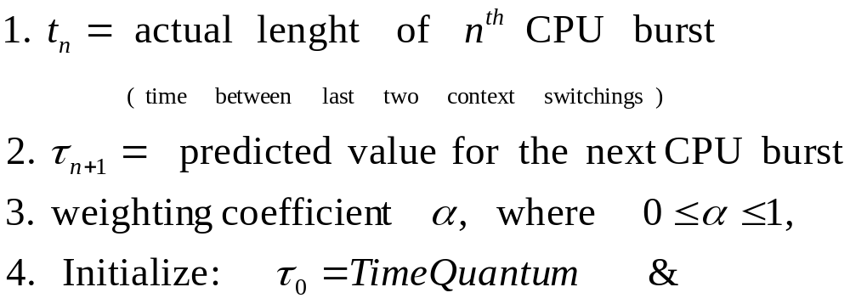
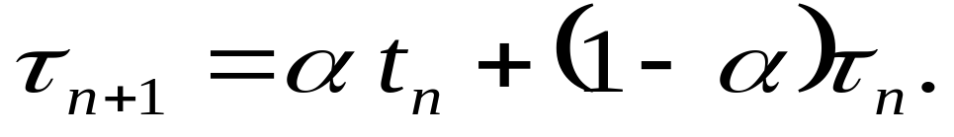
Estimating Length of Next CPU Burst
  User supplied estimate may be incorrect, so dynamic calculation based on last CPU burst (un interrupted usage). Associate with each process the length of its next CPU burst (). Use these estimates to schedule the process with the shortest CPU Burst time

Slide 22
Least Estimated Time First
  LETF: Use these estimated CPU burst time to schedule the process with the shortest CPU Burst time
Can estimate the length of CPU burst time
Can be done by using history, the length of previous CPU bursts, using exponential averaging
CPU allocation to any process with minimum estimated CPU burst time
This favors I/O bound processes over CPU bound processes

Slide 23

Prediction of the Length of the Next CPU Burst
(Initial estimate is set equal to 10)
Blue is estimated and Black is the actual CPU burst

Slide 24
Comments on Exponential Averaging
α =0 (Closer to estimated time)
  τ_{n+1} = τ_{n}
  Recent history does not count
α =1 (Closer to actual time)
  τ_{n+1} = α t_{n}
  Only the actual last CPU burst counts
If we expand the formula using successive τ_{n}, we get:
    τ_{n+1} = α t_{n}+(1 - α)α t_{n-1} + (1 - α )²α t_{n} ₋₂ + …
    +(1 - α )^{j} α t_{n} _{-j} + …
    +(1 - α )^{n +1} τ₀
Since both α and (1 - α) are less than or equal to 1, each successive term has lesser weight than its predecessor.
Current bursts affect more and previous history does not affect much
Over head: Needs estimation and comparisons of time
Favors I/O bound processes

Slide 25
Priority Scheduling
A priority number (integer) is associated with each process
    Fixed
    Dynamic: depending upon the behavior of process (Preemptive)
The CPU is allocated to the process with the highest priority (smallest nice integer ≡ highest priority on Unix)
    Preemptive
    Non-preemptive (only fixed priority)
SRTF may be a priority scheduling where priority is high on the smallest predicted next CPU burst time
Problem ≡ Starvation – low priority processes may hardly execute
Problem ≡ Priority Inversion
Solution ≡ Priority on Aging – as time progresses increase the priority of the process
(Starvation: Resources are denied for a very long time)
(Priority Inversion: A low priority job holds a resource, which is needed by the high priority job, while CPU is denied to low priority job)

Slide 26
Round Robin (RR)
Each process gets a small unit of CPU time (time quantum, usually 10-100 milliseconds). After this time, the process is preempted and added to the end of the ready queue.
Most democratic and fair (short/priority jobs don’t feel better), No threat of Starvation or Priority inversion
If there are n processes in the ready queue and the time quantum is q, then each process roughly gets 1/n of the CPU time in chunks of at most q time units at once. No process waits more than (n-1)q time units for next burst.
Performance
  q large ⇒ FIFO
  q small ⇒ q must be large with respect to context switching time, otherwise overhead becomes too high

Slide 27
Example of RR with Time Quantum = 20
P₄
P₃
P₂
P₁
CPU
Process CPU Burst Time
P₁ 53
P₂ 17
P₃ 68
P₄ 24
The Gantt chart is:
Typically, higher average turnaround than SJF, but better response
P₁
P₁
P₂
P₂
P₃
P₃
P₄
P₄
P₁
P₁
P₃
P₃
P₄
P₄
P₁
P₁
P₃
P₃
P₃
P₃
0
0
20
20
37
37
57
57
77
77
97
97
117
117
121
121
134
134
154
154
162
162

Slide 28
Round Robin Scheduling Policy:
Process Arrival Time Burst Time
P1 0 80
P2 20 60
P3 40 20
P4 50 40
P1 80 | P1 70 | P2 60 | P1 60 | P3 20 | P4 40 | P2 50 | P1 | P3 | P4 | P2 | P1 | P4 | P2 | P1 | P4 | P2 | P1 20 | P2 | P1
10 | 20 | 30 | 40 | 50 | 60 | 70 | 80 | 90 | 100 | 110 | 120 | 130 | 140 | 150 | 160 | 170 | 180 | 190 | 200
Waiting Time = Completion time – CPU Burst Time - Arrival Time
Waiting Time P1 = 200 – 80 – 0 = 120
Waiting Time P2 = 190 – 60 – 20 = 110
Waiting Time P3 = 90 – 20 – 40 = 30
Waiting Time P4 = 160 – 40 – 50 = 70
Waiting Time average = ( 120 + 110 + 30 + 70 ) / 4 = 330 / 4 = 82.5
Turnaround Time = Completion time – Arrival Time
Turnaround Time P1 = 200 – 0 = 200
Turnaround Time P2 = 190 – 20 = 170
Turnaround Time P3 = 90 – 40 = 50
Turnaround Time P4 = 160 – 50 = 110
Turnaround Time Average = (200 + 170 + 50 + 110 ) /4 = 530 / 4 = 132.5

Slide 29
First Come First Serve Scheduling Policy
Process Arrival Time Burst Time
P1 0 80
P2 20 60
P3 40 20
P4 50 40
P1 | P1 | P1 | P1 | P1 | P1 | P1 | P1 | P2 | P2 | P2 | P2 | P2 | P2 | P3 | P3 | P4 | P4 | P4 | P4
10 | 20 | 30 | 40 | 50 | 60 | 70 | 80 | 90 | 100 | 110 | 120 | 130 | 140 | 150 | 160 | 170 | 180 | 190 | 200
Waiting Time = Starting time – Arrival Time
Waiting Time P1 = 0 – 0 = 0
Waiting Time P2 = 80 – 20 = 60
Waiting Time P3 = 140 – 40 = 100
Waiting Time P4 = 160 – 50 = 110
Waiting Time average = 0 + 60 + 100 + 110 ) / 4 = 270 / 4 = 67.5
Turnaround Time = Completion time – Arrival Time
Turnaround Time P1 = 80 – 0 = 80
Turnaround Time P2 = 140 – 20 = 120
Turnaround Time P3 = 160 – 40 = 120
Turnaround Time P4 = 200 – 50 = 150
Turnaround Time Average = (80 + 120 + 120 + 150 ) /4 = 470 / 4 = 117.5

Slide 30
RR vs FCFS
Waiting Time P1 = 200 – 80 – 0 = 120
Waiting Time P2 = 190 – 60 – 20 = 110
Waiting Time P3 = 90 – 20 – 40 = 30
Waiting Time P4 = 160 – 40 – 50 = 70
Waiting Time average = 82.5
Turnaround Time P1 = 200 – 0 = 200
Turnaround Time P2 = 190 – 20 = 170
Turnaround Time P3 = 90 – 40 = 50
Turnaround Time P4 = 160 – 50 = 110
Turnaround Time Average = 132.5
Waiting Time P1 = 0 – 0 = 0
Waiting Time P2 = 80 – 20 = 60
Waiting Time P3 = 140 – 40 = 100
Waiting Time P4 = 160 – 50 = 110
Waiting Time average = 69.25
Turnaround Time P1 = 80 – 0 = 80
Turnaround Time P2 = 140 – 20 = 120
Turnaround Time P3 = 160 – 40 = 120
Turnaround Time P4 = 200 – 50 = 150
Turnaround Time Average = 117.5
  Round Robin is democratic, gives equal preference to every job
  Round Robin indirectly favors Short Jobs by avoiding Convoy Effect
  More responsive on short Time Quanta, at the cost of more Context Switching
  NO starvation
  Why better results for FCFS? …..

Slide 31

Time Quantum and Context Switch Time
If Time Quantum is of short duration then frequency of Context Switching is high

Slide 32

Turnaround Time Variation With The Time Quantum

Slide 33
Multilevel Queue
Ready queue is partitioned into separate queues:
Depending upon priorities/categories.
  foreground (interactive)
  background (batch or lengthy jobs)
Each queue has its own scheduling algorithm
  foreground – RR
  background – FCFS
Scheduling must be done between the queues
  Fixed priority scheduling; (i.e., serve all from foreground then from background). Possibility of starvation.
  Time slice – each queue gets a certain amount of CPU time which it can schedule amongst its processes; i.e., 80% to foreground in RR
  20% to background in FCFS

Slide 34

Multilevel Queue Scheduling

Slide 35
Multilevel Queue (MLQ)
A process can move between various queues; aging can be implemented this way
Multilevel-queue scheduler defined by the following parameters:
    number of queues
    First queue has highest priority
    Priority decreases downward
    Scheduling algorithms for each queue may be different
    method used to determine when to upgrade a process
    method used to determine when to demote a process
    method used to determine which queue a process will enter when that process needs service

Slide 36

Multilevel Feedback Queues
(automatic sorting, Time consuming jobs sink down)

Slide 37
Example of Multilevel Queue
Three queues:
  Q₀ – FIFO with time quantum 8 milliseconds
  Q₁ – FIFO time quantum 16 milliseconds
  Q₂ – FCFS
Scheduling
  A new job enters queue Q₀ which is served FCFS. When it gains CPU, job receives 8 milliseconds. If it does not finish in 8 milliseconds, job is moved to queue Q₁.
  At Q₁ job is again served FCFS and receives 16 additional milliseconds. If it still does not complete, it is preempted and moved to queue Q₂.

Slide 38
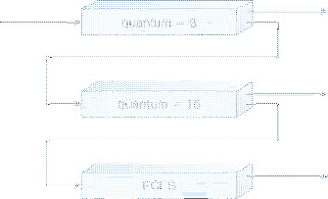
MLFQ
Multilevel Feedback Queue
New Arrival
CPU
Multiple FIFO queues are used
first queue has highest priority, priority decreases downward
New process is positioned at the end of the top-level FIFO queue.
When process reaches at the head of queue it is assigned the CPU.
    If the process is completed it leaves the system. (filtering of Short process)
    If the process uses all the quantum time, it is pre-empted and positioned at the end of the next lower level queue.
A process is given just one chance to complete at a given queue level
This will continue until the process completes or it reaches the base level queue.
    At the base level queue the processes circulate in round robin or FCFS fashion until they complete and leave the system.
Optionally, I/O bound processes are favored, if a process blocks for I/O, it is 'promoted' one level, and placed at the end of the next-higher queue.

Slide 39
Multiple-Processor Scheduling
CPU scheduling becomes more complex when multiple CPUs are available
Homogeneous processors within a multiprocessor system Uniform Memory Access
  Load sharing (Same code, easy scheduling)
  Complications; incase specific device is attached to private bus of one processor. Process needing that device shall be scheduled only on that processor.
Asymmetric multiprocessing
  Special purpose processors (I/O processor, math co-processor )
  General purpose processor (different set of instructions – not normally packed in one system)
  only one processor accesses the system data structures, alleviating the need for data sharing

Slide 40
Real-Time Scheduling
Hard real-time systems – required to complete a critical task within a guaranteed amount of time. (otherwise it will totally drop).
  Needs resource reservation
  Needs exact duration of different executing components (including OS components)
Soft real-time computing – requires that critical processes receive priority over less fortunate (important) ones

Slide 41
Thread Scheduling
Local Scheduling (within a process) – How the threads library decides which thread to put onto an available LWP
Global Scheduling (on system) – How the kernel decides which kernel thread to run next

Slide 42
Pthread Scheduling API
#include <pthread.h>
#include <stdio.h>
#define NUM THREADS 5
int main(int argc, char *argv[])
{
int i;
pthread t tid[NUM THREADS];
pthread attr t attr;
/* get the default attributes */
pthread attr init(&attr);
/* set the scheduling algorithm to PROCESS or SYSTEM */
pthread attr setscope(&attr, PTHREAD SCOPE SYSTEM);
/* set the scheduling policy - FIFO, RT, or OTHER */
pthread attr setschedpolicy(&attr, SCHED OTHER);
/* create the threads */
for (i = 0; i < NUM THREADS; i++)
pthread create(&tid[i],&attr,runner,NULL);

Slide 43
Pthread Scheduling API
/* now join on each thread */
for (i = 0; i < NUM THREADS; i++)
pthread join(tid[i], NULL);
}
/* Each thread will begin control in this function */
void *runner(void *param)
{
printf("I am a thread\n");
pthread exit(0);
}

Slide 44
Operating System Examples
Solaris scheduling
  Priority based with different classes:
    real-time: continues until blocked or preempted by higher priority
    System: reserved for fixed priority kernel tasks
    Interactive / time sharing: dynamic priority calculation. Varied time slice durations.
Windows XP scheduling
Linux scheduling

Slide 45
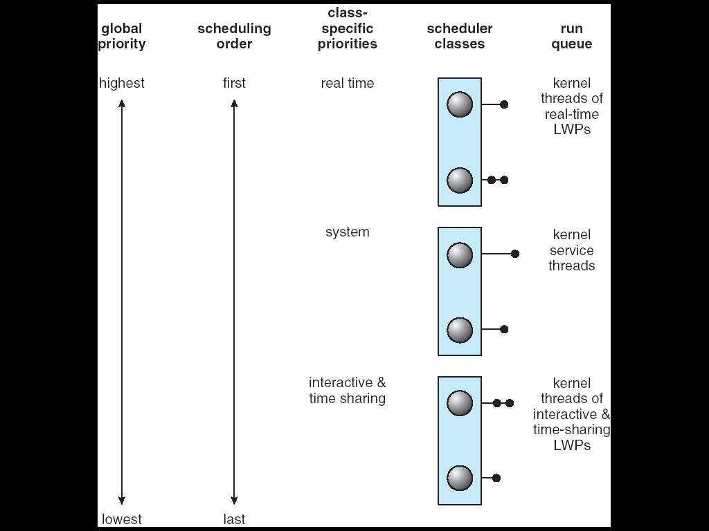
Solaris 2 Scheduling

Slide 46

Solaris Dispatch Table

Slide 47

Windows XP Priorities

Slide 48
Linux Scheduling
Two algorithms: time-sharing and real-time
Time-sharing
  Prioritized credit-based – process with most credits is scheduled next
  Credit subtracted when timer interrupt occurs
  When credit = 0, another process is chosen
  When all processes have credit = 0, re-crediting occurs
    Based on factors including priority and history
Real-time
  Soft real-time
  Posix.1b compliant – two classes
    FCFS and RR
    Highest priority process always runs first

Slide 49

The Relationship Between Priorities and Time-slice length

Slide 50

List of Tasks Indexed According to Priorities

Slide 51
Algorithm Evaluation
Deterministic modeling – takes a particular predetermined workload and defines the performance of each Scheduling algorithm for that workload evaluating
  Average waiting time and
  Turnaround time
Queuing models: deterministic model is too restrictive, knowing arrival rates, servicing rates, queue lengths the average waiting time and computer utilization can be computed.
Simulations

Slide 52

Evaluation; using simulated data.
Trace data can be generated using Random numbers, Organization specific trace tape can be generated, possibly biasing specific CPU-I/O bursts mix

Slide 53
Java Thread Scheduling
JVM Uses a Preemptive, Priority-Based Scheduling Algorithm
FIFO Queue is Used if There Are Multiple Threads With the Same Priority

Slide 54
Java Thread Scheduling (cont)
JVM Schedules a Thread to Run When:
  The Currently Running Thread Exits the Runnable State
  A Higher Priority Thread Enters the Runnable State
* Note – the JVM Does Not Specify Whether Threads are Time-Sliced or Not

Slide 55
Time-Slicing
Since the JVM Doesn’t Ensure Time-Slicing, the yield() Method May Be Used:
while (true) {
// perform CPU-intensive task
. . .
Thread.yield();
}
This Yields Control to Another Thread of Equal Priority

Slide 56
Thread Priorities
Priority Comment
Thread.MIN_PRIORITY Minimum Thread Priority
Thread.MAX_PRIORITY Maximum Thread Priority
Thread.NORM_PRIORITY Default Thread Priority
Priorities May Be Set Using setPriority() method:
setPriority (Thread.NORM_PRIORITY + 2);

